Slide 1

Usability and Evaluation Techniques
roberto.figlie@phd.unipi.it

Slide 2
Lesson outline
What does it mean and why?
Definitions
Heuristics evaluation
Cognitive Walkthrough
Types of testing
How to plan tests?
How to conduct tests?
Best practices
Testing Tools

Slide 3
What does it mean to test and why we should do it?

Slide 4
What does it mean to test and why we should do it?
When you have some sort of a prototype what you should want to do is testing with the users.
This is the process where you can evaluate a product or service by testing it directly with its intended users.
https://www.nngroup.com/articles/usability-testing-101/

Slide 5
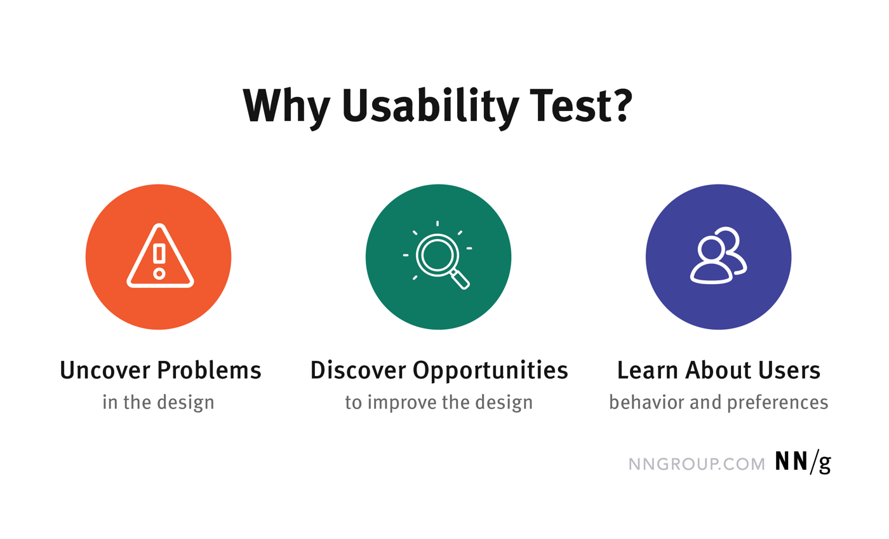
What does it mean to test and why we should do it?
In this way you can identify many (but not all) usability issues, opportunities for improvement, and how your users behave what they prefer.

Slide 6
But what is usability?
There are 2 definitions focusing on slightly different aspects:
Nielsen’s definition
ISO definition
The definition you adopt influences the type of test and experiment you will build.

Slide 7
Nielsen’s definition of Usability
Usability is a quality attribute that assesses how easy user interfaces are to use.
Usability is defined by 5 quality components:
Learnability: How easy is it for users to accomplish basic tasks the first time they encounter the design?
Efficiency: Once users have learned the design, how quickly can they perform tasks?
Memorability: When users return to the design after a period of not using it, how easily can they reestablish proficiency?
Errors: How many errors do users make, how severe are these errors, and how easily can they recover from the errors?
Satisfaction: How pleasant is it to use the design?
https://www.nngroup.com/articles/usability-101-introduction-to-usability/

Slide 8
ISO 9241-11 definition of Usability
Core idea: Usability is the degree to which a system/product/service enables specific users to achieve specified goals with effectiveness, efficiency, and satisfaction in a specific context of use (users, goals/tasks, resources, environments).
Outcome-of-use, not a property: ISO stresses usability is an outcome of interacting with the system; attributes can support it, but usability itself isn’t an intrinsic product trait.
2018 revision (vs 1998): broadened scope (systems & services), efficiency now tied to results achieved (not to accuracy/completeness), and satisfaction clarified to include a wider range of issues.

Slide 9
ISO 9241-11 : Effectiveness
Definition: Accuracy and completeness with which users achieve specified goals.
How to measure:
Task-success rate (% completed correctly).
Error rate / error-free rate.
Decision accuracy (e.g., % correct selections, precision/recall in retrieval).
Outcome completeness (e.g., all required fields/steps done).

Slide 10
ISO 9241-11 : Efficiency
Definition: Resources used in relation to the results achieved; typical resources: time, human effort, cost, materials.
How to measure:
Time on task (median/percentiles per successful task).
Throughput (tasks/hour) or steps/keystrokes/clicks per task.
Human effort via validated workload scales (e.g., NASA-TLX, SWAT, MRQ).
Cost per correct outcome (support, rework, consumables) when relevant.

Slide 11
ISO 9241-11 : Satisfaction
Definition: The extent to which users’ physical, cognitive, and emotional responses from use meet their needs and expectations; anticipated use can shape satisfaction with actual use.
How to measure:
SUS (System Usability Scale) for overall perceived usability.
UMUX-Lite for perceived usefulness/usability when SUS is too long.
Specific usability scales such as CUS (Chatbot Usability Scale)
Reporting tip: Separate satisfaction (subjective) from effectiveness/efficiency (objective), but analyze them together to explain divergences (i.e., fast but frustrating).

Slide 12
Usability and Utility
Other than usability another key concept in UX design is utility, which refers to the design's functionality: Does it do what users need?
Usability and utility are equally important and together determine whether something is useful:
It matters little that something is easy if it's not what you want.
It's also no good if the system can hypothetically do what you want, but you can't make it happen because the user interface is too difficult.
To study a design's utility, you can use the same user research methods that improve usability.

Slide 13
Usability + Utility
Utility = whether it provides the features you need.
Usability = how easy & pleasant these features are to use.
Useful = usability + utility.
Note that usually you will find mention to usability only: it is not conceptually right but it makes it easier to refer to the type of testing.

Slide 14
User and Usability testing
So, testing is essential in creating products that meet user needs and expectations following the principles of Human-Centered Design.
Only discovering usability issues and testing with real users you can create an improved user experience that leads you to higher user satisfaction, and ultimately drive business success.

Slide 15
Heuristics evaluation

Slide 16
Heuristic evaluation
Before testing with real users, something else can be done to discover usability issues.
Heuristic evaluation is a method used to evaluate user interfaces based on established usability principles or "heuristics". This evaluation typically involves a small team of evaluators, as the process can be challenging for a single individual to complete. Also, involving multiple evaluators (3-5 are enough) can improve the accuracy of the evaluation.
Although heuristic evaluation does not provide a systematic approach to fixing usability problems or assessing redesigns, it can guide the creation of revised designs based on the violated principles of good interactive systems in a cost-effective way.

Slide 17
Heuristic evaluation, Nielsen (1992)
proportion of usability problems found
100 %
75 %
50 %
25 %
0 %
0
5
10
15
number of evaluators

Slide 18
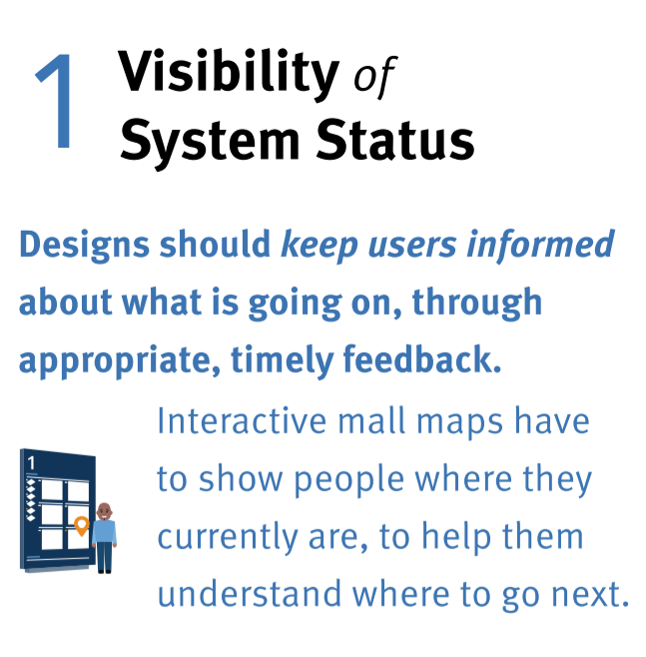
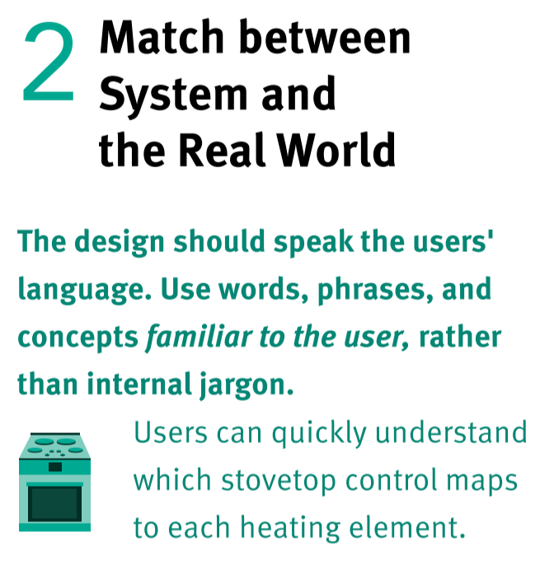
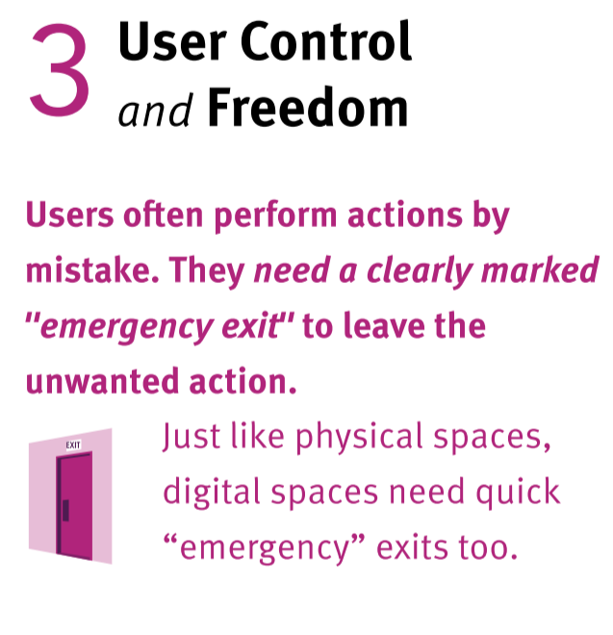
Nielsen’s 10 Usability Heuristics

Slide 19
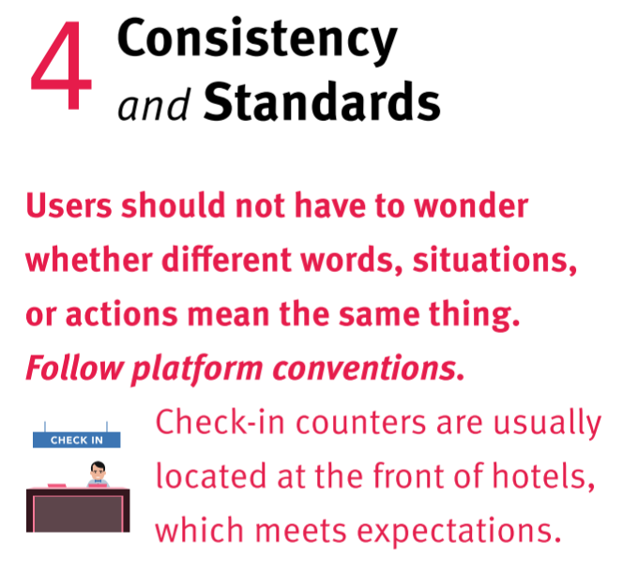
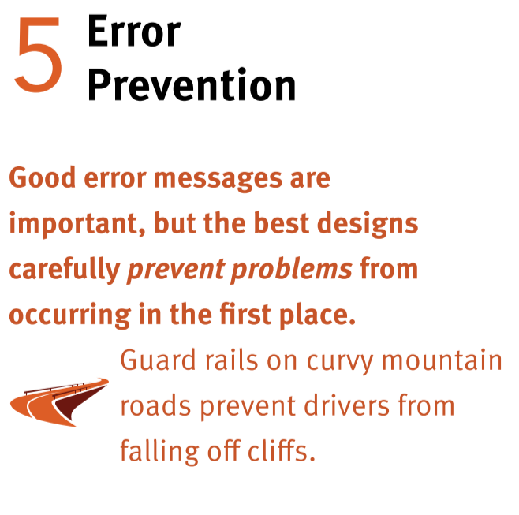
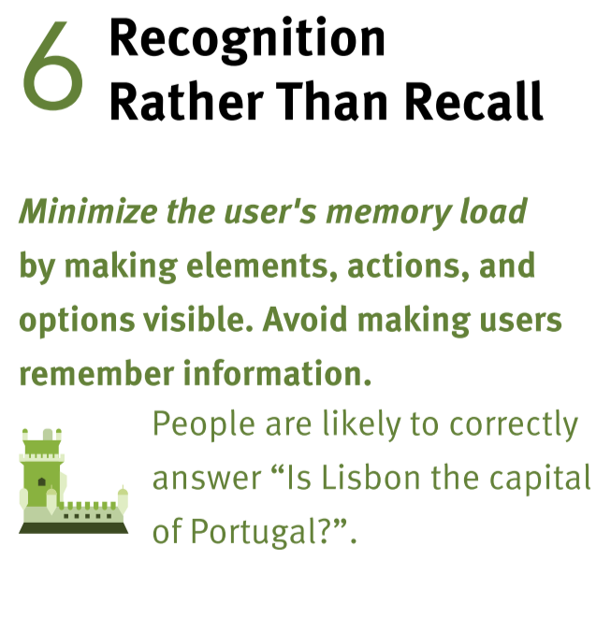
Nielsen’s 10 Usability Heuristics

Slide 20
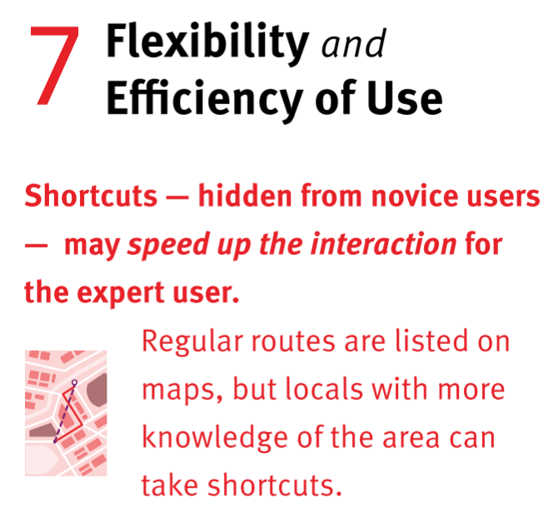
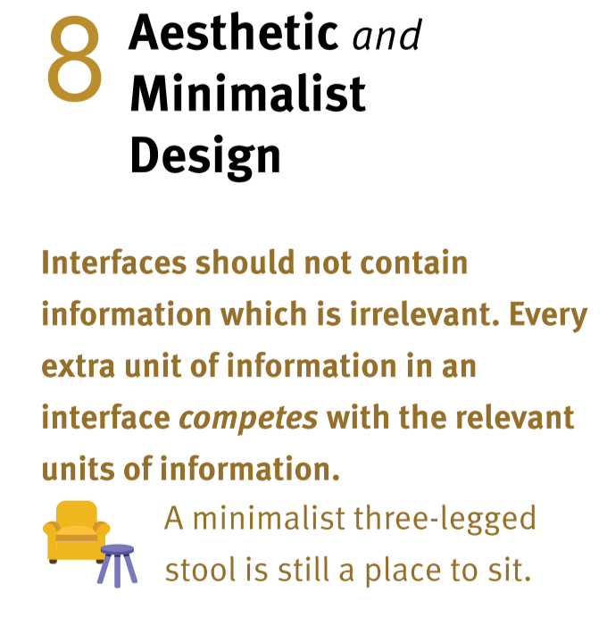
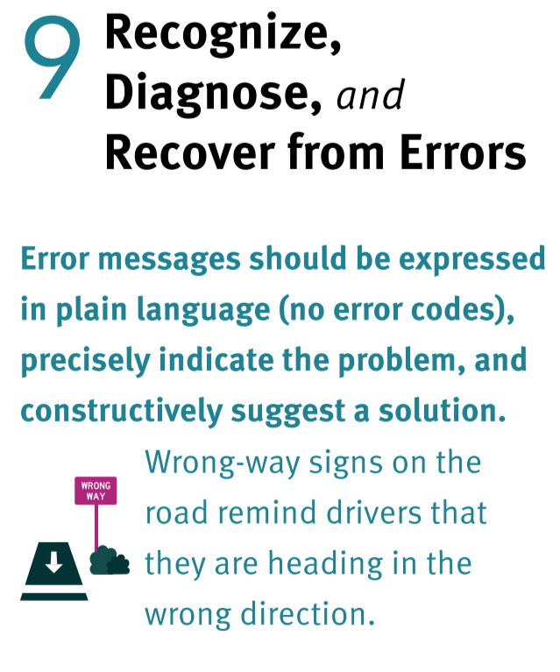
Nielsen’s 10 Usability Heuristics

Slide 21
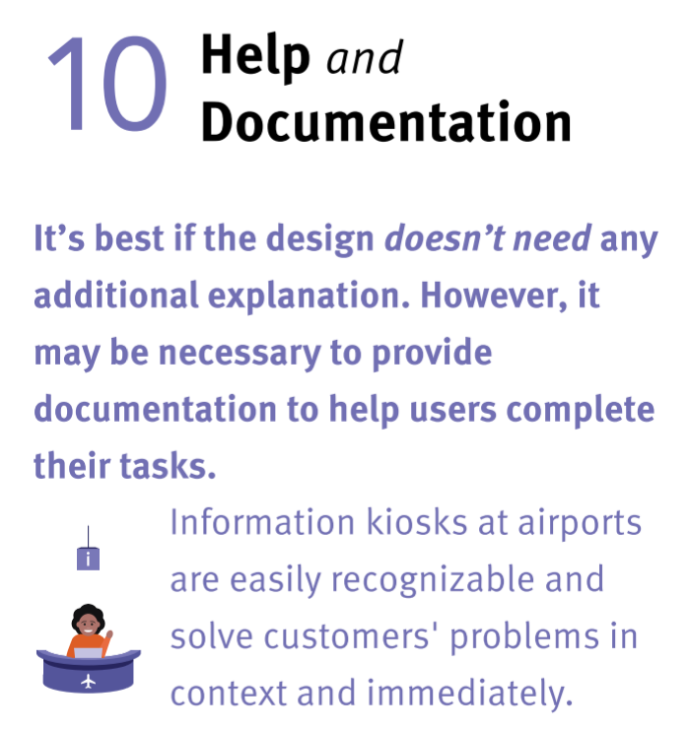
Nielsen’s 10 Usability Heuristics

Slide 22
Cognitive
Walkthrough

Slide 23
Cognitive Walkthrough
Evaluation method based on the idea that…
the user learns about the interface in an exploratory way,
the user has goals,
the user is applying simple means-ends reasoning.
Source: Dr Elke Duncker, School of Computing Science,
University of Middlesex. Designing Interactive Systems' (CMT4240)

Slide 24
Cognitive Walkthrough
Evaluation by an expert, who goes through a set of tasks while imitating user performance.

Slide 25
Preparation: We need four things
User description including level of experience with computers and any assumptions made by the designer
System description including operations and performance (e.g. paper design)
Task description specifying the task that the expert has to carry out from users point of view
Action sequence describing the system display and the user actions needed to complete the given task. One system display and one user action together are one step.

Slide 26
Process of carrying out a Cognitive Walkthrough
Prototype, user description, system description, task description and action list has to be prepared by the designer/developer
Designer gives these documents to an expert.
The expert reads the descriptions.
The expert carries out the task by following the action list.

Slide 27
Questions Cognitive Walkthrough
The expert asks the following questions with EACH step of the action list:
Is the next goal clear at this stage?
Is the appropriate action obvious?
Is it clear that this action leads to the goal?
What problems are there in performing the action?

Slide 28
Elements of Usability Testing

Slide 29
User and Usability testing
As a user research methodology we define a a usability-testing session when a researcher (called a “facilitator” or a “moderator”) asks a participant to perform tasks, usually using one or more specific user interfaces.
While the participant completes each task, the researcher observes the participant’s behavior and listens for feedback.
https://www.youtube.com/watch?v=v8JJrDvQDF4

Slide 30
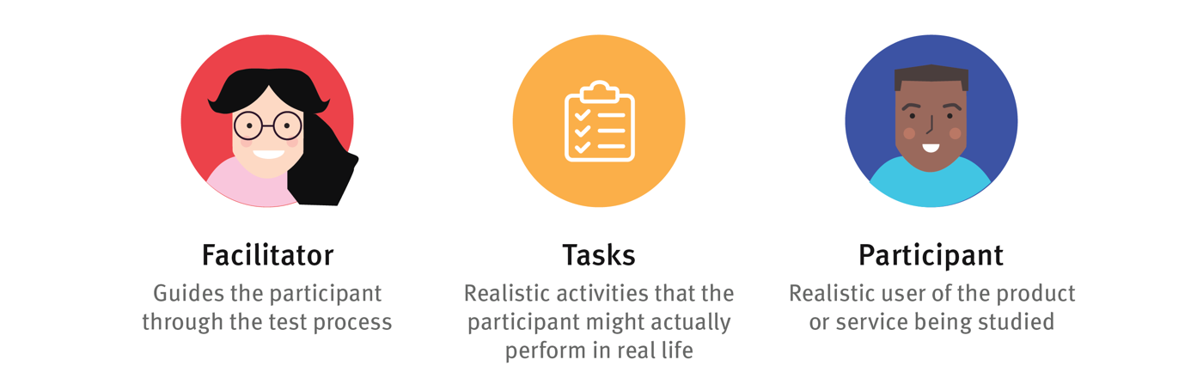
Elements of Usability Testing

Slide 31
The Facilitator
The facilitator guides the participant through the test process. The facilitator:
gives instructions,
answers the participant’s questions,
and asks follow up questions.
The facilitator works to ensure that the test results in high-quality, valid data, without accidentally influencing the participant’s behavior. Achieving this balance is difficult and requires training.

Slide 32
The tasks
The tasks in a usability test are realistic activities that the participant might perform in real life. They can be very specific or very open-ended, depending on the research questions and the type of usability testing.
A few examples of tasks:
Your printer is showing “Error 5200”. How can you get rid of the error message?
Find out articles that uses Cloud technologies to solve a warehouse management problem. Can you find them? How?

Slide 33
The tasks
Task wording is very important in usability testing. Small errors in the phrasing of a task can cause the participant to misunderstand what they’re asked to do or can influence how participants perform the task (a psychological phenomenon called priming).
Task instructions can be delivered to the participant verbally (the facilitator might read them) or can be handed to a participant written on task sheets.
If you give them written tasks ask participants to read the task instructions out loud. This helps ensure that the participant reads the instructions completely, and helps the researchers with their notetaking, because they always know which task the user is performing.

Slide 34
The Participant
The participant should be a realistic user of the product or service being studied. That might mean that the user is already using the product or service in real life. Alternatively, in some cases, the participant might just have a similar background to the target user group, or might have the same needs, even if he isn’t already a user of the product.
Ideally you should select them starting from the personas you made.
Participants are sometimes asked to think out loud during usability testing (called the “think-aloud method”). The facilitator might ask the participants to narrate their actions and thoughts as they perform tasks. The goal of this approach is to understand participants’ behaviors, goals, thoughts, and motivations.

Slide 35
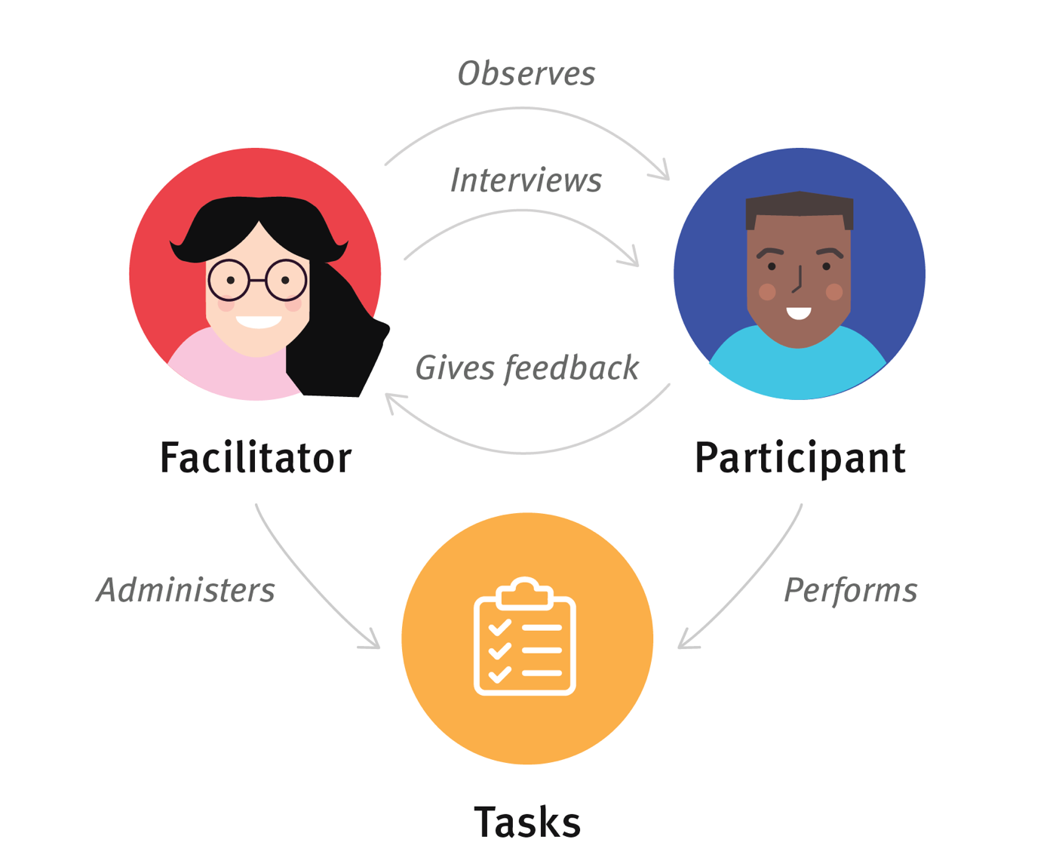
Elements of Usability Testing

Slide 36
Types of usability testing

Slide 37
Qualitative vs Quantitative
There are 2 types of usability testing depending on the data you can collect:
Qualitative (qual) data, consisting of observational findings that identify design features easy or hard to use.
Quantitative (quant) data, in form of one or more metrics (such as task completion rates or task times) that reflect whether the tasks were easy to perform.

Slide 38
Qualitative vs Quantitative
Qualitative testing typically involves gathering data through open-ended questions, observations, and user interviews to gain insight into how users interact with a product and what their feelings and opinions are about it.
It is often conducted in the early stages of the design process to help designers understand user needs, goals, and pain points. But it can also be used to validate design decisions and test prototypes before launching a product or service.

Slide 39
Qualitative vs Quantitative
Quantitative testing is a research method that involves collecting and analyzing numerical data (metrics) to measure user behavior and attitudes towards a product or service. It typically involves gathering data through surveys, analytics, A/B testing, and other quantitative research methods.
The goal of quantitative testing is to provide designers with statistically significant data that can be used to make informed design decisions. By collecting quantitative data, designers can measure user behavior and preferences in a more objective and systematic way, making it easier to identify patterns and trends.
Quantitative testing can be used throughout the design process, from the early stages of research and discovery to testing and validating design decisions. It can be especially useful for measuring the effectiveness of design changes and improvements over time.

Slide 40
Qualitative vs Quantitative
Both qualitative and quantitative testing are important methods in UX design, and they complement each other well. Qualitative tests can help designers understand the "why" behind user behavior, while quantitative tests can provide a more comprehensive understanding of user behavior and preferences.

Slide 41
 | Qualitative Research | Quantitative Research
Questions answered | Why? | How many and how much?
Goals | Both formative and summative: inform design decisions identify usability issues and find solutions for them | Mostly summative: evaluate the usability of an existing site track usability over time compare site with competitors compute ROI
When it is used | Anytime: during redesign, or when you have a final working product | When you have a working product (either at the beginning or end of a design cycle)
Outcome | Findings based on the researcher’s impressions, interpretations, and prior knowledge | Statistically meaningful results that are likely to be replicated in a different study
Methodology | Few participants Flexible study conditions that can be adjusted according to the team’s needs Think-aloud protocol | Many participants Well-defined, strictly controlled study conditions Usually no think-aloud

Slide 42
How to plan and conduct usability tests

Slide 43
Planning a test - The goal
First of all you have to define the purpose of your research. What do you want to test? What is the end goal in conducting tests?
This will first lead you to understand if you need qualitative or quantitative research.

Slide 44
Planning a test - The format
In lab or in field: consider the location: should it be in-house or at the participant's location?
Moderated or unmoderated: Moderated studies provide richer insights and better access to open-ended comments but cost more and difficult to organize. Unmoderated studies can be cheaper, quicker and may provide better access to hard-to-recruit participants.
In-person or remote: In-person studies are recommended whenever possible as they allow for more personable interaction and the ability to detect subtle cues, but remote studies can be more accessible and sometimes necessary due to budget or logistical constraints.

Slide 45
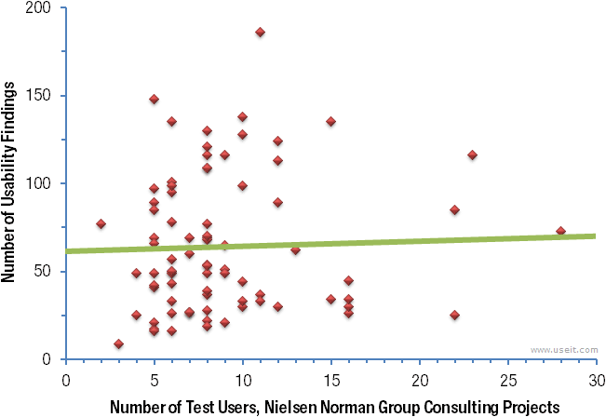
Planning a test - number of participants
How many testers?
Jakob Nielsen highlighted that 5 people is a good number for qualitative studies as more will not guarantee you many other insights.
However, this will not apply to quantitative studies! Here the recommended number is at least 20.

Slide 46
Planning a test - Recruit the Right Participants
To get the most valuable insights from user testing, it's important to use representative participants who match the demographics and behaviors of your target users.
Avoid asking proxy users to pretend or imagine scenarios, as this can lead to invalid results. This is especially important for specialized websites and content-rich or B2B sites, where finding exact matches for your target users is crucial.

Slide 47
Planning a test - Write the right tasks
In usability testing, tasks are written as scenarios and should match the study goals. Tasks can be exploratory or specific:
exploratory tasks are open-ended and used for learning how people explore information (not suited for quantitative research),
specific tasks are focused and have a correct answer or end point, and can be used for both qualitative and quantitative testing.
Also, pay attention to the wording of the task! (More on this later)

Slide 48
Planning a test - Rehearse it fist
Before conducting usability testing, run a pilot study to refine task wording, determine task order and quantity, and ensure you are recruiting the right participants.
This is especially important for online unmoderated studies where there is no opportunity for clarification or correction during the session.
Catching problems early can prevent issues during the actual testing session.

Slide 49
Planning a test - Decide the metrics (if any)
Qualitative usability studies prioritize gaining design insights over measuring usability, as metrics are unlikely to be representative for the whole user population with few users. So here you would decide the questions to be made if you are thinking to a structured (or semi-) interview.
However, in quantitative studies with well-defined tasks and a large number of users, measuring usability is important and common metrics include time on task, satisfaction ratings, success rate, and error rate.
If collecting subjective measurements, decide when to give questionnaires: after each task, at the end of the session, or both.

Slide 50
Planning a test - Write down the plan
Once you’ve figured out how you’re going to conduct the research, document your approach in a test plan and share it. This document serves as a communication tool among team members and a record for future studies. The document doesn’t need to be lengthy, but should contain key information such as:
Name of the product or site being testing
Study goals
Logistics: time, dates, location, and format of study
Participant profiles
Tasks
Metrics, questionnaires
Description of the system (e.g., mobile, desktop, computer settings)

Slide 51
Planning a test - Don’t do it alone
You won’t catch all the details, or take all the notes.
You will always lose something along the way, so it is way better to have other testers with you, especially if you are conducting a qualitative study.

Slide 52
10 things to avoid when testing

Slide 53
10 things to avoid when testing
1. Telling Users Where to Go. To avoid priming, remove any words that appear in your interface, so you give yourself a fair chance to see if users can find their way around the site.
2. Telling Users What to Do. Don't warn participants about the steps they need to take, such as registering or downloading, to gather valuable feedback about their experience and potential issues that may arise.
3. Creating Out-of-Date Tasks. If the task is to find a flight leaving February 20, don’t run that test on February 22. A task about the latest news on a site should be updated the day before or the day of testing to include current content.
4. Making Tasks Too Simple. Your goal isn’t to make tasks too simplistic or unnecessarily complex, but to give users a realistic task that requires processing, rather than just locating information.

Slide 54
10 things to avoid when testing
5. Creating an Elaborate Scenario. Using scenarios in user testing tasks can provide context and help participants understand the purpose of the task, but should be used with caution as they may add unnecessary complexity and increase the cognitive load for users. Scenarios should be kept simple and not used to justify unusual or unrealistic activities.
6. Writing an Ad, not a Task. Make sure your tasks don’t include marketing phrases like “exciting new feature,” business phrases like “thinking outside the box,” or mysterious corporate acronyms. Use user-centric language, not maker-centric language.
7. Risking an Emotional Reaction. Part of the responsibility of running a usability test is to ensure the well-being of your participants. Stick to harmless and vague relationships instead – friend, colleague, a friend’s child.

Slide 55
10 things to avoid when testing
8. Trying to Be Funny. Don’t joke, use famous names in tasks, or otherwise try to lighten the mood. Doing so can backfire and make some participants feel awkward or, even worse, as though you are making fun of them.
9. Offending the Participant. Avoid potentially offensive details in tasks. Societal issues, politics, health, religion, age, and money all have the possibility of offending a participant.
10. Asking Rather than Telling. Don’t ask participants “how would you” complete a task — unless you want them to talk you through what they theoretically would do on a site, rather than doing it. The point of usability testing is to see what users do, not to hear what they would do.

Slide 56
For more information and details on usability testing:
https://www.nngroup.com/articles/qual-usability-testing-study-guide/
https://www.nngroup.com/articles/quantitative-research-study-guide/

